Slide 1
Maximum 𝑘-Plex Search: An Alternated Reduction-and-Bound Method Shuohao Gao, Kaiqiang Liu, Shengxin Liu, Cheng Long Proceedings of the VLDB Endowment (PVLDB) 2025

Slide 2
I. Introduction

Slide 3
1.1 Maximum k-plex Search
A graph G = (V, E) is a k-plex if each vertex have at most 𝑘 non-neighbors (including itself).
We aim to find the largest 𝑘-plex in the given graph.
a
a
a
d
b
d
b
d
b
c
c
c
(I) a clique
(II) a 2-Plex
(III) non-neighbors of a
Notes:
The problem we wis to explore is maximum k-plex search.
Here we provide its definition without talking too many details.
Then we jump to the constraints of existing frameworks.

Slide 4
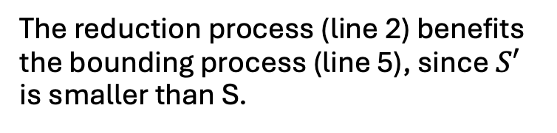
1.2 Existing Frameworks
The reduction process (line 2) benefits the bounding process (line 5), since $S′$ is smaller than S.
The bounding process cannot help the reduction process, since reduction rules usually don’t rely on bounding info.
Notes:
Akhlaque will ask “how benefit each other”
Both Prof. Yan and Akhlaque have not read this paper thoroughly, I cannot assume they share my context
Maybe here we need to illustrate the constraint of the sequential strategy
---
Existing frameworks will consume an input graph G and returns P, the maximum k-plex of G.
First, we will do some preprocessing.
P is initialized as a relatively large k-plex from G.
In addition, unpromising vertices and edges will be removed from G through CTCP, core-truss co-pruning.
Afterwards, we will pop vertices from G and iteratively update P.
In each step, we will create a branch (S, C). S is a k-plex and C is a candidate set.
We invoke the branch-and-bound method to incrementally insert vertices from C into S
If S is larger than P, P will be replaced with S.
In this branch-and-bound method, there are two procedures that are executed sequentially:
the reduction process that remove unpromising vertices from the candidate set C; these removed vertices cannot appear in a 𝑘 -plex larger than |P|
2) the bounding process will update P if we find a better candidate.
However, existing frameworks have some constraints.
Specifically, …
To solve this problem, …

Slide 5
II. Alternated Reduction and Bound

Slide 6
2.1 An Overview of the New Framework
Notes:
As shown in the slide, the new framework follows the same pattern as existing ones.
The main difference is that we invoke BRB_Rec, a method that allows the reduction process and the bounding process to benefit from each other.

Slide 7
2.2 Alternated Reduction-and-Bound (AltRB)
Notes:
The audience will not understand “bounding process and reduction process benefit each other” before know the reduction rules and computeUB
The audience will fall into details, such as partition.
---
This paper proposes AltRB, alternated reduction-and-bound, which differs from existing frameworks mainly in the way of conducting the reduction and bounding.
Specifically, both S and C will be partitioned into two parts; 𝑆 into 𝑆𝐿 and 𝑆𝑅; 𝐶 into 𝐶𝐿 and 𝐶𝑅.
Afterwards, AltRB will alternatively and iteratively conducts the reduction process and the bounding process at each part of a branch
For example, bounding on 𝑆𝐿 and 𝐶𝐿, then reduction on 𝑆𝑅 and 𝐶𝑅, bounding on 𝑆𝑅 ∪𝐶𝑅, reduction on 𝑆𝐿 ∪ 𝐶𝐿 , and so on.
The function returns C*, a refined candidate set after removing unpromising vertices,
And UB, an upper bound of the size of k-plexs constructed from the current branch.
With novel reduction rules, the bounding process and the reduction process could mutually benefit from each other
So that we can achieve better runtime efficiency.

Slide 8
2.3 AltRB: Partition
C_{L}
Notes:
Equation 5 is misleading, LB is defined from lemma 4.1
Add illustration for H SL, CL
Why UB != computeUB(S,C) is a fixed point?
---
The next topic is about the upper bound and lower bound of different partitions.
1) For the upper bound, ComputeUB is an existing upper bound computation technique proposed by a paper in 2023.
(“A Refined Upper Bound and Inprocessing for the Maximum 𝑘-Plex Problem.” )
Here we will not talk about it details since it is not part of the current framework.
2) For the lower bound, Assume H is a k-plex from the current branch such that H is larger than P.
lemma 4.1 indicate the relation between the lower bound of one partition of the branch
with the upper bound of another, which allows us to define the lower bounds in equation (5) and (6).

Slide 9
2.3 AltRB: Partition
Notes:
Equation 5 is misleading, LB is defined from lemma 4.1
Add illustration for H SL, CL
Why UB != computeUB(S,C) is a fixed point?
---
The next topic is about the upper bound and lower bound of different partitions.
1) For the upper bound, ComputeUB is an existing upper bound computation technique proposed by a paper in 2023.
(“A Refined Upper Bound and Inprocessing for the Maximum 𝑘-Plex Problem.” )
Here we will not talk about it details since it is not part of the current framework.
2) For the lower bound, Assume H is a k-plex from the current branch such that H is larger than P.
lemma 4.1 indicate the relation between the lower bound of one partition of the branch
with the upper bound of another, which allows us to define the lower bounds in equation (5) and (6).

Slide 10
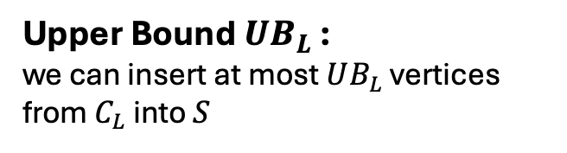
2.3 AltRB: Upper Bounds
Upper Bound $UB_{L}$ :
we can insert at most $UB_{L}$ vertices from $C_{L}$ into $S$
Notes:
We cannot highlight ”reduction rules using LB and UB” directly, because the audience feel confused with the definition of LB and UB
--
Here we showcase these two reduction rules without going through their implementation details.
However, we have two key observations.
1) These reduction rules rely on upper bounds and lower bounds of the branch’s two partitions.
2) We use reduction rules and the ComputeUB method to remove unpromising vertices, so that we have tighter upper and lower bounds.
These two observations enable the alternative and iterative updating.
In contrast, an existing framework doesn’t have this kind of flexibility.
Since its reduction rules are only based on S, which will not be changed after the current function returns.
Hence, repeating it multiple times cannot result in the same improvement as AltRB.
In summary, the alternative strategy of AltRB, as well as the refined reduction rules, allows us to update P more frequently.

Slide 11
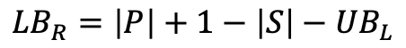
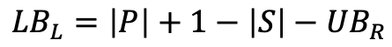
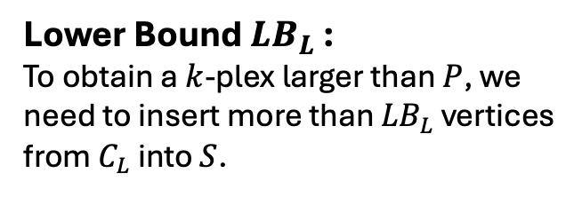
2.3 AltRB: Lower Bounds
Lower Bound ${LB}_{L}$ :
To obtain a $k$-plex larger than $P$, we need to insert more than ${LB}_{L}$ vertices from $C_{L}$ into $S$.
$${LB}_{L}=\left|P\right|+1−\left|S\right|−{UB}_{R}$$
$${LB}_{R}=\left|P\right|+1−\left|S\right|−{UB}_{L}$$
Notes:
We cannot highlight ”reduction rules using LB and UB” directly, because the audience feel confused with the definition of LB and UB
--
Here we showcase these two reduction rules without going through their implementation details.
However, we have two key observations.
1) These reduction rules rely on upper bounds and lower bounds of the branch’s two partitions.
2) We use reduction rules and the ComputeUB method to remove unpromising vertices, so that we have tighter upper and lower bounds.
These two observations enable the alternative and iterative updating.
In contrast, an existing framework doesn’t have this kind of flexibility.
Since its reduction rules are only based on S, which will not be changed after the current function returns.
Hence, repeating it multiple times cannot result in the same improvement as AltRB.
In summary, the alternative strategy of AltRB, as well as the refined reduction rules, allows us to update P more frequently.

Slide 12
2.3 AltRB: Reduction and Bound
Notes:
Equation 5 is misleading, LB is defined from lemma 4.1
Add illustration for H SL, CL
Why UB != computeUB(S,C) is a fixed point?
---
The next topic is about the upper bound and lower bound of different partitions.
1) For the upper bound, ComputeUB is an existing upper bound computation technique proposed by a paper in 2023.
(“A Refined Upper Bound and Inprocessing for the Maximum 𝑘-Plex Problem.” )
Here we will not talk about it details since it is not part of the current framework.
2) For the lower bound, Assume H is a k-plex from the current branch such that H is larger than P.
lemma 4.1 indicate the relation between the lower bound of one partition of the branch
with the upper bound of another, which allows us to define the lower bounds in equation (5) and (6).

Slide 13
2.3 AltRB: Reduction Rule I
RR1
Notes:
We cannot highlight ”reduction rules using LB and UB” directly, because the audience feel confused with the definition of LB and UB
--
Here we showcase these two reduction rules without going through their implementation details.
However, we have two key observations.
1) These reduction rules rely on upper bounds and lower bounds of the branch’s two partitions.
2) We use reduction rules and the ComputeUB method to remove unpromising vertices, so that we have tighter upper and lower bounds.
These two observations enable the alternative and iterative updating.
In contrast, an existing framework doesn’t have this kind of flexibility.
Since its reduction rules are only based on S, which will not be changed after the current function returns.
Hence, repeating it multiple times cannot result in the same improvement as AltRB.
In summary, the alternative strategy of AltRB, as well as the refined reduction rules, allows us to update P more frequently.

Slide 14
2.3 AltRB: Reduction Rule I
RR1
Notes:
Equation 5 is misleading, LB is defined from lemma 4.1
Add illustration for H SL, CL
Why UB != computeUB(S,C) is a fixed point?
---
The next topic is about the upper bound and lower bound of different partitions.
1) For the upper bound, ComputeUB is an existing upper bound computation technique proposed by a paper in 2023.
(“A Refined Upper Bound and Inprocessing for the Maximum 𝑘-Plex Problem.” )
Here we will not talk about it details since it is not part of the current framework.
2) For the lower bound, Assume H is a k-plex from the current branch such that H is larger than P.
lemma 4.1 indicate the relation between the lower bound of one partition of the branch
with the upper bound of another, which allows us to define the lower bounds in equation (5) and (6).

Slide 15

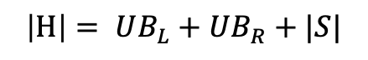
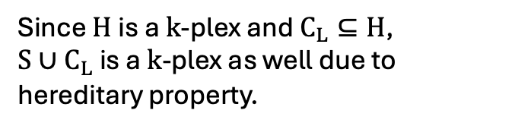
2.3 AltRB: Reduction Rule II
RR2
$$\left|H\right|= UB_{L}+UB_{R}+|S|$$
Since $H$is a $k$-plex and $C_{L}⊆H$,
$S∪C_{L}$ is a $k$-plex as well due to hereditary property.
$$H∩C_{L}=C_{L}$$
Notes:
We cannot highlight ”reduction rules using LB and UB” directly, because the audience feel confused with the definition of LB and UB
--
Here we showcase these two reduction rules without going through their implementation details.
However, we have two key observations.
1) These reduction rules rely on upper bounds and lower bounds of the branch’s two partitions.
2) We use reduction rules and the ComputeUB method to remove unpromising vertices, so that we have tighter upper and lower bounds.
These two observations enable the alternative and iterative updating.
In contrast, an existing framework doesn’t have this kind of flexibility.
Since its reduction rules are only based on S, which will not be changed after the current function returns.
Hence, repeating it multiple times cannot result in the same improvement as AltRB.
In summary, the alternative strategy of AltRB, as well as the refined reduction rules, allows us to update P more frequently.

Slide 16

2.3 AltRB: Reduction and Bound
RR2
$S∪C_{L}$ not a $k$-plex, terminate
Notes:
Equation 5 is misleading, LB is defined from lemma 4.1
Add illustration for H SL, CL
Why UB != computeUB(S,C) is a fixed point?
---
The next topic is about the upper bound and lower bound of different partitions.
1) For the upper bound, ComputeUB is an existing upper bound computation technique proposed by a paper in 2023.
(“A Refined Upper Bound and Inprocessing for the Maximum 𝑘-Plex Problem.” )
Here we will not talk about it details since it is not part of the current framework.
2) For the lower bound, Assume H is a k-plex from the current branch such that H is larger than P.
lemma 4.1 indicate the relation between the lower bound of one partition of the branch
with the upper bound of another, which allows us to define the lower bounds in equation (5) and (6).

Slide 17
2.4 Experiments
kPEX
More solved instances (left)
Significant speedup on the majority (right)
more stable than baselines when varying 𝑘 (both)
Notes:
kPEX outperforms all base- lines for all tested values of 𝑘 in the number of solved instances . For example, kPEX solves 12 instances more than the best baseline KPLEX for 𝑘 = 10 within 3600 seconds.
kPEX is more stable than baselines when varying 𝑘. In contrast, there is an obvious drop in solved instances for kPlexT and DiseMKP as 𝑘 increases from 2 to 20.
kPEX outperforms all baselines in runtime by achieving significant speedups on the majority graphs.

Slide 18
Thanks

Slide 19
Contents
Introduction
Alternated Reduction-and-Bound
Other Techniques

Slide 20
III. Other Techniques
Notes:
The experiment section is enough.

Slide 21
3.1 KPHeuris
Exsiting heuristic:
Iteratively removing vertices from G until the remaining graph is a k-plex
KPHeuris:
incrementally including vertices into the current k-plex
More efficient:
since the size of the largest k-plex is much smaller than the input graph
Notes:
This explanation somehow makes sense to Akhlaque.
But we may need same illustration (one degeneracy; one incrementally add vertices from S to G).
---
Finally, the authors propose KPHeuris for better efficiency.
Existing heuristic processes, such as kPlex-Degen, compute a large 𝑘-plex by iteratively removing a vertex from the input graph 𝐺
based on a certain ordering until the remaining graph becomes a 𝑘-plex.
KPHeuris differs from this strategy.
It computes a large 𝑘-plex by iteratively including a vertex, which is more efficient since the size of the largest 𝑘-plex is usually much smaller than the size of the input graph.

Slide 22
3.2 Core-First Core-Truss Co-Pruning (CF-CTCP)
CTCP: removing edges, then one vertex
CT-CTCP: removing vertices, then one edge
Notes:
We need to justify CF-CTCP with more details.
“through” executes first
---
In CTCP, The idea of refining the input graph 𝐺 is to remove vertices and edges that cannot appear in any 𝑘-plex larger than the current P.
To improve its efficiency, we propose core-pruning-first core-truss co-pruning (or CF-CTCP), which differs from CTCP in the way of conducting pruning at each round.
Specifically,
CTCP first removes all unpromising edges and then one unpromising vertex
CF-CTCP first removes all unpromising vertices and then removes one unpromising edge
The benefit for such a strategy is that unpromising vertices can be removed immediately via efficient core pruning.
Even though both of them produce the same result, CF-CTCP requires less computation since it reduces the size of the candidate set more efficiently.

Slide 23
3.1 Effectiveness of Techniques
AltBB:
5x on 12 out of 30 graphs
CF-CTCP:
5x on 8 out of 30 graphs
KPHeuris:
Speedup on 23 of 30 graphs
Notes:
kPEX outperforms all base- lines for all tested values of 𝑘 in the number of solved instances . For example, kPEX solves 12 instances more than the best baseline KPLEX for 𝑘 = 10 within 3600 seconds.
kPEX is more stable than baselines when varying 𝑘. In contrast, there is an obvious drop in solved instances for kPlexT and DiseMKP as 𝑘 increases from 2 to 20.
kPEX outperforms all baselines in runtime by achieving significant speedups on the majority graphs.

